Slide 1
Bidder’s Conference: One-Stop Career Center Operator Services in the Metro North Region
November 13, 2019
11am-12:30PM Eastern Time
Via Webinar
**PLEASE TYPE NAME AND ORGANIZATION INTO THE CHAT BOX**

Slide 2
BEFORE WE GET STARTED…
PLEASE TYPE NAME AND ORGANIZATION INTO THE CHAT BOX
EVERYONE IS MUTED UNTIL THE Q&A AT THE END TO REDUCE BACKGROUND NOISE
ASK QUESTIONS VIA THE CHAT BOX
WILL ADDRESS QUESTIONS AT THE END
ANSWERS ARE NOT FINAL UNTIL POSTED ON RFP WEBPAGE
WEBINAR IS BEING RECORDED. WILL BE POSTED TO RFP WEBPAGE

Slide 3
AGENDA
OVERVIEW OF MASSHIRE METRO NORTH WORKFORCE BOARD
WIOA OVERVIEW
RESOURCES
PURPOSE OF RFP
METRO NORTH CAREER CENTER VISION
FUNDS AVAILABLE
BUDGET
ELIGIBLE BIDDERS AND OTHER SELECTION CONSIDERATIONS
SUBMISSION PROCESS AND REVIEW PROCESS
PROPOSAL CONTENT
OTHER NEXT STEPS AND QUESTIONS

Slide 4
OVERVIEW OF MASSHIRE METRO NORTH WB
1 of 16 Workforce Development Boards in the Commonwealth
Promote programs and policies that enable residents to maximize economic self-sufficiency and businesses to have access to a productive workforce
Set local workforce policy
Determine how to best utilize workforce development funds
Develop partnerships to align the needs of employers to residents and maximize resources in the region
Oversee Metro North One-Stop Career Centers

Slide 5
WORKFORCE INNOVATION AND OPPORTUNITY ACT (WIOA)
Signed into law July 2014
First legislative reform of the public workforce system in 16 years
Funded through the U.S. Department of Labor to help job seekers access employment, education, training, and match employers with skilled workers
Requires each Workforce Board to competitively procure One-Stop Career Center Operator(s) to provide career, training, and employer services

Slide 6
RESOURCES
Local: FY’17 – FY’20 Strategic Plan (masshiremetronorth.org)
Regional: Greater Boston Regional Planning Blueprint (masshiremetronorth.org)
State: Policies (http://www.mass.gov/massworkforce)
Federal: WIOA Law and Regulations (https://www.doleta.gov/WIOA/), WIOA Final Rules (https://www.doleta.gov/wioa/about/final-rules/)

Slide 7
PURPOSE OF RFP
To select a qualified One-Stop Career Center operator(s) to provide career, training, and employer services under WIOA and other public and private funding.
Innovative service delivery to provide services to unemployed and underemployed adults, dislocated workers, youth and employers.

Slide 8
WIOA CORE PARTNERS
Massachusetts Rehabilitation Commission
Department of Transitional Assistance
Adult Education and Literacy Providers
Older Americans Act Providers
Department of Unemployment Assistance
Veterans
Trade Adjustment Act
Massachusetts Commission for the Blind

Slide 9
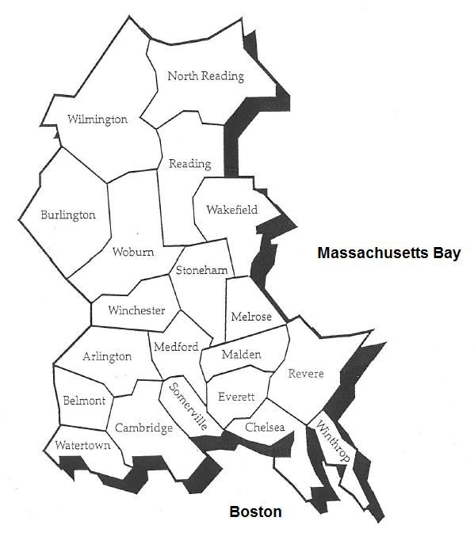
METRO NORTH REGION
North: Burlington, Melrose, North Reading, Reading, Stoneham, Wakefield, Wilmington, Winchester, and Woburn. South: Arlington, Belmont, Cambridge, Chelsea, Everett, Malden, Medford, Revere, Somerville, Watertown, and Winthrop

Slide 10
METRO NORTH CAREER CENTER VISION-
EMPLOYER SERVICES
The Career Center is the human resource vendor of choice for local companies
Industry-occupational experts with relationships with companies in Metro North targeted industries
Examples of employer services:
Advertise Job Openings
Customized Recruitments
Customized Screening of Applicants
Job Profiling
Job Matching
Provide Access to Space
Conduct Job Fairs

Slide 11
METRO NORTH CAREER CENTER VISION-
INDIVIDUALS WITH BARRIERS TO EMPLOYMENT
Provide innovative services to the following populations:
Individuals with basic skills deficiency
Limited English speakers
Highly educated immigrants
Veterans
Individuals with criminal backgrounds
Recipients of public assistance

Slide 12
METRO NORTH CAREER CENTER VISION-
CUSTOMER ACCESS AND INNOVATION
Customer Access
Through multiple entry points – more flexible system
Innovative strategies to reach customers across region – access points, virtual services, partnerships, etc.
Innovation
Innovative strategies to deliver employer and job seeker services

Slide 13
WIOA CAREER AND EMPLOYER SERVICES
Employer Services
Customized Recruiting and Screening Services
Information and Technical Assistance
Employer Professional Development
Career Services
Basic Services
Individualized Services
Training Services
Follow-up Services

Slide 14
WIOA DISLOCATED WORKER AND ADULT SERVICES
Receive funds to provide targeted individualized and case management services to eligible customers
Responsible for eligibility determination and registration
Offer and provide in-depth individualized career services
Process Individual Training Account (ITA) vouchers for customers entering occupational skills or education training
Alternative training models
Career pathways

Slide 15
WIOA DISLOCATED WORKER AND ADULT SERVICES
Receive funds to provide targeted individualized and case management services to eligible customers
Responsible for eligibility determination and registration
Offer and provide in-depth individualized career services
Process Individual Training Account (ITA) vouchers for customers entering occupational skills or education training
Alternative training models
Career pathways

Slide 16
CAREER CENTER FUNDING AVAILABILITY AND BUDGET FORMS
Approximately $3.2M estimated for FY2021 (pgs. 23-26)
Refer to pages 38-39 for Budget Form instructions
Complete Excel budget forms in this order as each auto fills the next:
1. Salaries- Complete the FTE (i.e., .5, 1) under the location (form will then auto fill the FTE column)
2. Budget
3. Narrative

Slide 17
NEW OPERATOR CONSIDERATIONS
Carry-over of customers already receiving services
Current locations
Start-up costs are allowable costs
Performance based and cost reimbursable funding
Interviewing all current interested staff

Slide 18
ELIGIBLE BIDDERS
Private, for profit or non-profit company or a government agency. Eligible bidders include:
Institutions of higher education;
Community organizations;
Non-traditional public schools, e.g., night or adult school, career or technical education school;
Workforce intermediaries;
Business organizations, including chambers of commerce;
Labor organizations;
Staffing or talent companies; and
A consortium of public agencies.
* Elementary and secondary schools are not eligible bidders.

Slide 19
CONSORTIUMS AND SUBCONTRACTING
Lead agency for the collaborative or partnership
Roles and responsibilities of each collaborator
Organizational chart
Flow of funds
Partner’s fiscal responsibility
Qualified fiscal agent

Slide 20
SUBMISSION PROCESS
Letters of Intent are required by November 22, 2019
Proposals are due by 4:00pm on December 20, 2019
One original and 12 hard copies of completed proposal(s) are due at the Metro North WB’s office, 186 Alewife Brook Parkway, Suite 216, Cambridge, MA 02138, no later than 4:00pm, December 20, 2019.
Flash drive including one PDF (narrative, attachments) and one EXCEL (budget)

Slide 21
EVALUATION CRITERIA
Criteria | Point Value
Organizational Structure and Capacity | 15
Staff Plan and Qualifications | 15
Program Design | 25
Past Performance and Planned Outcomes | 10
Financial Structure and Fiscal Plan | 10
Customer Access | 15
Innovation | 10
Total Points Available | 100

Slide 22
PROPOSAL CONTENTS
Please submit proposal in this order:
1. Cover Page
2. Partnership Form
3. Executive Summary
4. Narrative Response
5. Career Center RFP Budget, Budget Narrative, and Salaries Chart
6. Organization Chart
7. Memorandum of Understanding (MOU) with partners (if a partnership application)
8. Summaries of Key Personnel/Job Descriptions
9. Fiscal Questionnaire
10. List of Board Members (names, business mailing address, affiliation, e-mail and phone numbers)
11. IRS W-9 Request for Taxpayer Identification Number and Certifications*
12. If applicable, current Determination Letter from IRS verifying the organization is exempt from federal income tax under section 501(c)(3)*
13. Certificate of Good Standing (from the Massachusetts Department of Revenue at www.mass.gov/dor)*
14. Tax Exemption Certificate*
15. Most recent IRS Form 990 (non-profit tax return) and MA Form PC (annual nonprofit state filing)*
16. Copy of most recent financial audit*
17. Signed Statement of Compliance and Disclaimer*
18. Certificate of Lobbying Activities (Link to pdf included)*
19. One-Stop Center Checklist*
*Only needed in the original copy

Slide 23
NEXT STEPS
Bidder’s Conference PowerPoint and recording will be posted on website by 11/15/19
Letter of Intent required by 11/22/2019
Open Q&A period through 12/13/19
Amendments and Q&A will be posted on the website
Proposals due 12/20/19
Anticipated contract(s) commencement: 7/1/2020

Slide 24
QUESTIONS?

