Slide 1

BIDDER’S CONFERENCE:
METRO NORTH YOUTHWORKS 24-25 RFP
CONTACT RFP@MASSHIREMETRONORTH.ORG FOR FURTHER QUESTIONS YOU MAY HAVE AFTER THIS PRESENTATION
rfp@masshiremetronorth.org

Slide 2

Program description
What is YouthWorks?
YouthWorks is a state-funded youth employment program that helps teens and young adults gain the skills and experience needed to find and keep jobs and begin to design a path toward sustained successful career.
The program aims to address juvenile delinquency and youth homelessness in high-risk areas by engaging participants aged 14 to 25. These participants may identify as lesbian, gay, bisexual, transgender, queer and/or questioning, come from diverse racial backgrounds, possess varying abilities, represent different national origins and religions, or belong to low-income households, including those with a single income, and individuals facing housing insecurity.

Slide 3
Served Population
Population Served
YouthWorks Tiers Breakdown
The YouthWorks program serves a wide range of participants in terms of ages, levels of career awareness, and goals. To provide all participants with effective and relevant youth workforce development services, YouthWorks consists of four specific tiers: Service and Project-based Learning for 14-15-year-olds, Early and Career Trajectory Experiences for 16-17-year-olds, Career Pathway Training and Support for 18-21-year-olds and Emerging into Career and Career Management for 22-25-year-olds.

Slide 4
Served Population
Population Served
YouthWorks Tiers Breakdown
Tier 1: Service And Project-Based Learning
Tier 2: Early and Career-Trajectory Experience
Tier 3: Career Pathway Training and Support
Tier 4: Career Pathway Credentialing and certifications
  For 14-15 year-old participants engaged in supportive work-based learning with an emphasis on preparation for future employment experiences.
  Emphasis on teambuilding and project-based experience
  For 16-17 year-old participants building skills through substantial subsidized work placements ranging from first jobs to career oriented paid internships.
  Core employability skills emphasized
  For 18-21 year-old participants developing the occupational skills and experience to enact personal career plans and obtain entry-level positions in high-demand fields.
  Career pathway focused with more self-reflection
  For 22-25 year-old participants building skills through career based credentialing programs in high demand fields
  Career Pathway focused on gaining hard skills

Slide 5
Served Population
Population Served
Eligibility Criteria
#1: Age
#2: Income
#3: Residency
#4: Risk Factors
  Participants must be between the ages of 14 and 25 years old
  Participants should have a family income that does not exceed the annual equivalent of 200% of the Federal poverty guidelines.
  Income documentation is not required for youth who are documented as housing insecure, in foster care, or for youth with disabilities or special needs.
  Participants must reside within the Metro North region
  The Metro North region consists of the following twenty cities and towns north of Boston: Arlington, Belmont, Burlington, Cambridge, Chelsea, Everett, Malden, Medford, Melrose, North Reading, Reading, Revere, Somerville, Stoneham, Wakefield, Watertown, Wilmington, Winchester, Winthrop, and Woburn.
  • Program eligibility is based on Age, Income, and Metro North Residency. Risk Factors are NOT required for eligibility but should complete a self-attestation at the time of enrollment.
  • Outreach to youth from vulnerable populations listed on page 4 in the Diversity, Equity, and Inclusion section of the RFP should be included in the narrative response question #1: Provide details about the overall recruitment efforts of the region.

Slide 6

Region Lead Entity
MassHire Metro North Workforce Board as the Lead Entity
In the Metro North region, the MassHire Metro North Workforce Board (MNWB) is the lead entity and fiscal agent for the YouthWorks program. MNWB prepares the regional application to CommCorp’s YouthWorks Request for Responses (RFR) and is the contractor to CommCorp for the region program.
MNWB, as regional lead, provides support and technical assistance to all YouthWorks program partners. MNWB YouthWorks staff will be your first point of contact for any program support needed.
The following list provides details about the support services:
  Bi-weekly and monthly meetings to provide necessary support and updates for the region that come from CommCorp
  Site visits: Informal Observation, Participant Interview/Focus Groups
  Database support
  Support for effective program design, implementation, and assessment
  Support with budget modifications

Slide 7
Provider’s Program Expectations
A primary focus at MNWB is our dedication to enhancing and delivering high-quality programs for young individuals throughout the Metro North region. MNWB is looking for providers that foster and advocate for a wide range of meaningful work experiences in high demand industries for the Metro North region. Interested providers should submit a program plan that demonstrates how the proposed service model will offer impactful experiences for at-risk youth and young adults in the Metro North region. MNWB anticipates providers will propose innovative approaches with strategic partnerships that will provide Metro North youth with quality work experiences and career development opportunities.
Furthermore, in its role as the YouthWorks lead entity in the Metro North region, MNWB is devoted to incorporating Diversity, Equity, and Inclusion into the programs and services offered to our communities. Our vision is to foster a flourishing, inclusive, and resilient regional economy, ensuring that businesses and youth residents have fair access to workforce development resources and quality employment opportunities. Therefore, programs are expected to serve vulnerable participants who can self-attest to one or more of the following at-risk factors:
  court-involved;
  Department of Youth Services (DYS)-committed, on juvenile probation, gang-involved, CRS, juvenile arrest;
  homelessness or being a runaway, including young people who identify as lesbian, gay, bisexual, transgender, queer, and questioning, in addition to youth of color;
  foster care or being close to aging out of foster care; having aged out of foster care;
  poor academic performance or a school stop-out;
  single parent household;
  having a disability or special needs;
  lack of fluency in English, or being a foreign immigrant; or
  being a teen parent.
Sub-Grantees

Slide 8
Provider’s Program Expectations
Case Management & Enrollment
  Providers should carefully consider the target population and identify the strongest skill sets required to explore specific topics and establish connections to academic interests
  Participants must meet all the eligibility requirement in order to participate in the program
  Providers are responsible for keeping on file all eligibility documents submitted by participants - up to 5-7 years on file
  All programs should plan to provide participants who need a device to access programming with a Chromebook or entry-level laptop for virtual and/or hybrid programming
  Program supports should ensure participants have signed-off on the “Participation Agreement” in the database, acknowledging they understand what is required and expected of them as a participant of the YouthWorks program
  Throughout case management, address barriers and provide referrals as needed
  Organize and conduct regular check-ins with participants
  All programs need to identify additional modes of case management beyond email and voicemails if only operating in a virtual modality
Signal Success
  Review participant progress and provide feedback to their self-paced work in addition to ensuring participants are meeting required Signal Success hours
  Facilitate live Signal Success curriculum within local programming
  Ensure the completion of Signal Success/career readiness hours as outlined in the RFP
Sub-Grantees

Slide 9
Provider’s Program Expectations
Career Exploration
  Providers should plan and facilitate career exploration opportunities
  Engage participants in career exploration opportunities provided by MNWB and CommCorp
Interview Preparation
  Organize mock interviews for participants
  Encourage participants to use Talk Hiring for mock interviews practice connected to their field of interest
Subsidized Work Placement
  Identifying, developing, and monitoring supportive placements that include mentoring and support for participants
  In the case of shorter placements, aligning them to additional opportunities like Career Chats and Micro Career Pathway courses, when offered
Commitment to Participant Wage, Safe and Appropriate Working Environments
  All subsidized placements in the YouthWorks program must include an hourly wage no less than the Massachusetts minimum wage of $15.00/hr. All hourly wages must align with the tiered wage ranges provided.
  Providers must ensure that site supervisors provide a comprehensive orientation including but not limited to the use of safety equipment and any tools/equipment which will be used by participants.
  Providers must ensure that all participants are provided with the necessary equipment and supplies needed to complete any assignments.
  Providers must ensure that worksites post Child Labor Laws, when appropriate, and ensure participants are aware of workers’ rights.
  Providers must ensure that worksites sponsored by faith-based organizations may not engage participants in activities that are religious in nature. For example, it is not appropriate for YouthWorks participants to be asked to teach religious studies.
Sub-Grantees

Slide 10
Provider’s Program Expectations
Reporting
  The MassHire Metro North Workforce Board will be responsible for providing all partners access to the YouthWorks reports, as well as collecting all data from partners for submission through the YouthWorks database. Dates for when reports are due for submission are established by the Commonwealth Corporation. All partners are responsible and required to complete reports before the due date
  Providers are required to report individual YouthWorks participant record data, including social security numbers
  Whether a program uses their own application process or not, every participant MUST have an application on file -- the free, online application for participant completion will be provided in March by the Commonwealth Corporation or at the completion of the new system – whichever comes first.
Data Tracking
  Providers are required to track and upload all youth data to the YouthWorks database. It is a contractual obligation that all partners upload their youth data to the YouthWorks database and keep track of youth performance using the YouthWorks database.
Youth Engagement & Opportunities
  Providers are being asked to strategically plan and offer a diverse array of work and learning experiences tailored to the interests and needs of YouthWorks program participants.
  It is anticipated that providers will intensify their efforts in expanding partnerships, specifically, in the private sector.
  Providers will be tasked with expanding employer recruitment to align with high-growth career pathways and industries outlined in Regional Blueprints and identified as priorities by the Healey-Driscoll Administration, including life sciences, healthcare and human services, clean energy, and advanced manufacturing.
Note: Worksites under contracted ARPA dollars cannot include lobbying organizations (501(c)4s) or cannabis companies.
Sub-Grantees

Slide 11
Provider’s Program Expectations
Funding Match Expectation
  Based on the awarded contract amount, providers/sub-grantees are assigned private sector match targets of, at least 10%, cash match for program expenditures.
  To be considered, match must come from private sector commitments – additional wages for participants – and not from other public funds that may be used to support the program. Match can be documented as paid placements in any brokered youth employment programs including Connecting Activities.
  For city funded mayoral programs, city-funded programs would not be considered a match contribution.
  Private-sector employers includes private-sector enterprises and private nonprofit organizations such as private hospitals, colleges, universities, and others.
  Budgets submitted should include stipends/wages within the approved wage range. Programs expecting to provide stipends/wages higher than the approved wage through match, should incorporate that information in their match report not application budget narrative.
Sub-Grantees

Slide 12
Comparing FY23 to FY24
FY24
Funding Differences | FY23 | FY24
Total funding available across State Total awarded to MNWB Bidding process | $32,670,000 (including ARPA) $3,565,955.37 (including requested mods of increase) Competitive | $19,912,757.00 TBD Competitive
Program Changes
Tier 4 Data collection Signal Success | Implementation of Tier 4; CPR/First aid training required YouthWorks Database; grant reporting Creation of new Signal Success content for Tier 4 | Continued focus on the separation of Tier 3 and Tier 4; focus on private sector partnerships; CPR/First Aid made a requirement only for Tier 4 Fewer grant reporting; transition to new system (for data collection -TBD); adjusted application process Revised/new Signal Success for Tier 1-3; adjusted self-paced platform (LMS)
Key Operational Changes
Wages Participant fringe Systems Connecting to CA, WIOA youth, and STEM | Wages increased $1.25/tier 12% Skills Library Database; Interim applications for participants Shared language | Wages across all tiers begin at $15 as a floor base 14% Building new database system More cross-collaboration; ensuring participants are marked as co-enrolled if they also receive support through either CA, STEM, WIOA

Slide 13
Evaluation Criteria
MassHire Metro North Workforce Board Evaluation Criteria
  Recruitment Plan
  Program Overview
  Program Design
  Case Management
  Employer and Partnership Outreach:
As we continue to expand the YouthWorks program by establishing and fostering partnerships, networks, and relationships with businesses within the region and throughout the state, it is anticipated that partners will also intensify their efforts in expanding partnerships, specifically, in the private sector.
Also, building on the recommendations of the Climate Chief and the Governor’s Office of Climate Innovation and Resilience, as a region, we are urged to involve partners/employers offering opportunities in clean energy, climate, and resiliency. The application will require information on employer partnerships and a breakdown of sites by industry or sector.
  Budget/Budget Narrative
  Program Operations and Staffing Plan

Slide 14





Age | Total Responses
14 years old | 6
15 years old | 20
16 years old | 19
17 years old | 20
18 years old | 4
19 years old | 3
20+ years old | 1
Youth Surveys
Youth Survey Reponses

Slide 15
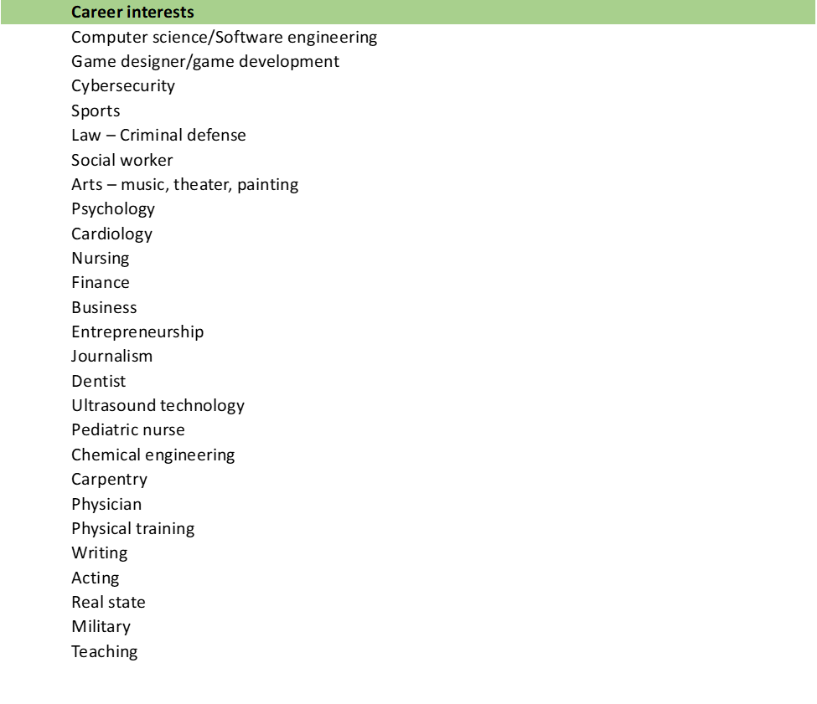
Youth Surveys
Youth Survey Reponses
46 of the responses indicated that their worksite placement for the summer aligned with their career interest, while 24 of the responses indicated that their worksite placement did not align with their career interests.

Slide 16
Youth Surveys
Youth Survey Reponses
Internships/placements participants would like to see:
  More computer related internships/more tech related internships
  Law
  Politics
  Acting
  More non-profit organizations that work on community issues
  Health care/Mental health care
  Food service
  Local newspaper or TV station
  Architecture/design
  Medical field
  Lots of positive feedback for RIOT specially from those who are still undecided and aren’t really set on a specific career.
  Retail
  Childcare
  Childhood education
  Arts
  Culinary internships
  Real state
Note: lots of the answers pointed that the participants wish to have more interactions with people.

Slide 17
MNWB Expectations for Sub-grantees officially contracted
  Monthly submission of invoices during programming;
  monthly submission of back-up documentation reconciling cash requests and invoice amounts;
  regular data entry during active performance periods;
  complete and accurate reporting of participants – All YouthWorks participants must report social security numbers for evaluation purposes.
  engage and maintain new partnerships in various career fields;
  engage new partnerships within the private sector
  engage participants in Commonwealth Corporation programming including but not limited to participants engaging in Micro Career Pathways courses;
  recruit and make best efforts to retain participants;
  attend virtual, regional, local meetings;
  attend bi-weekly and monthly check-in meetings with MNWB
  support the organizing of regional site visits by MNWB and the Commonwealth Corporation, when needed;
  timely contract closeout – submission of final invoices and reports; and
  complete reporting of program – the YouthWorks database asks to report whether a YouthWorks participant is co-enrolled in certain other programs, including WIOA Title I Youth, Connecting Activities, and others. Sub-grantees must ensure the full reporting of program leverage information.
Contracted Sub-Grantees

Slide 18
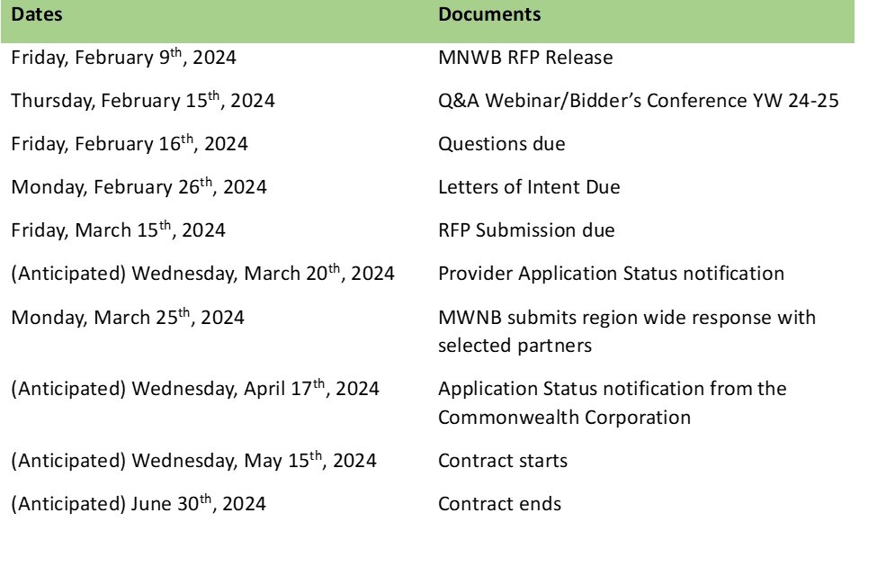
Region Lead Entity
Application & Evaluation Process Timeline:

Slide 19
Q&A | THANK YOU!
CONTACT RFP@MASSHIREMETRONORTH.ORG FOR FURTHER QUESTIONS YOU MAY HAVE AFTER THIS PRESENTATION.
rfp@masshiremetronorth.org

